Slide 1
Github, R Tricks, Visual Studio Coding
Aight y’all, time to UP YOUR GAME

Slide 2
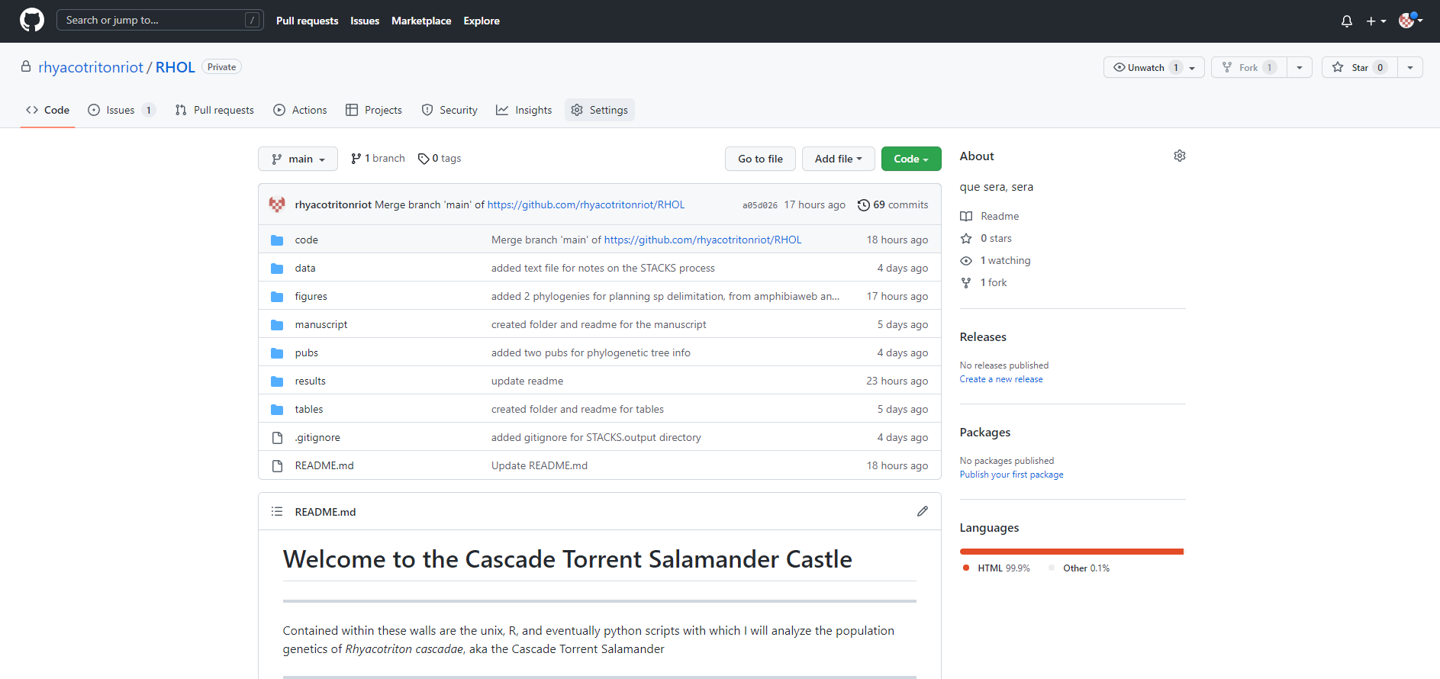
Github

Slide 3
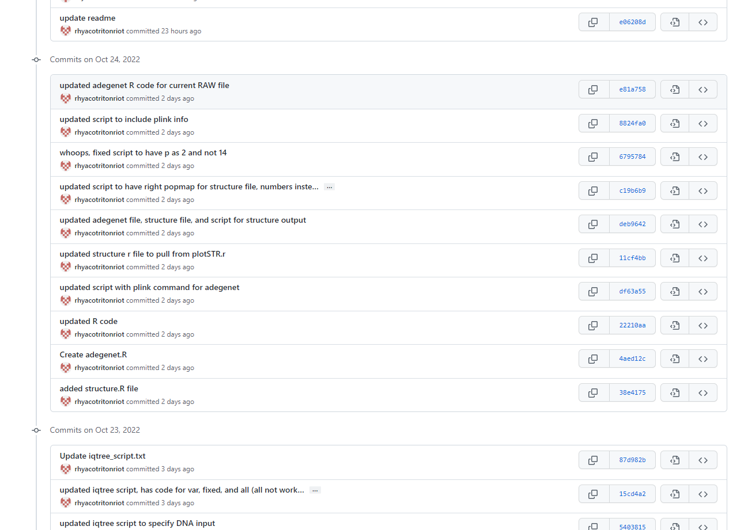
Github – Version Control

Slide 4
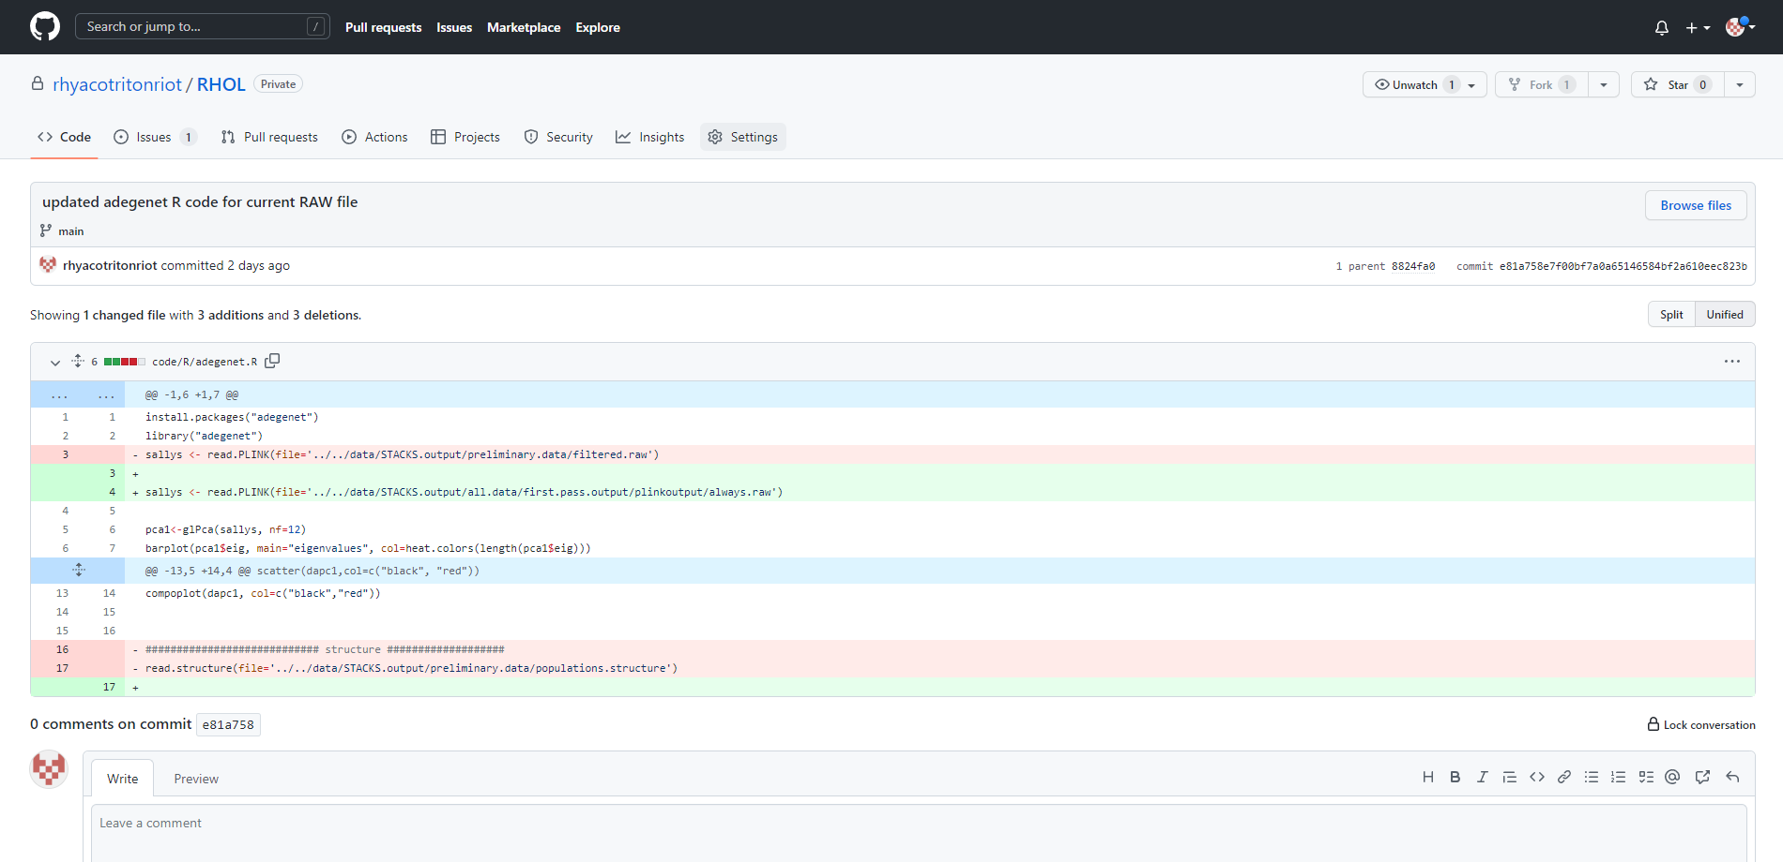
Github – Version Control

Slide 5
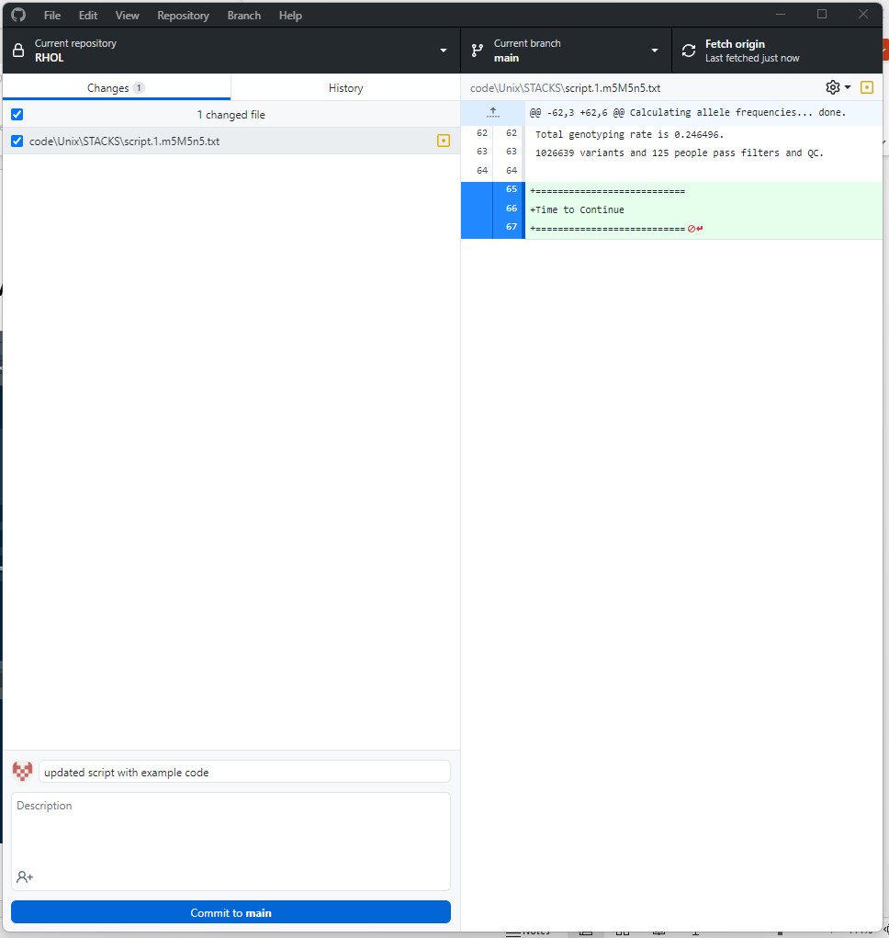
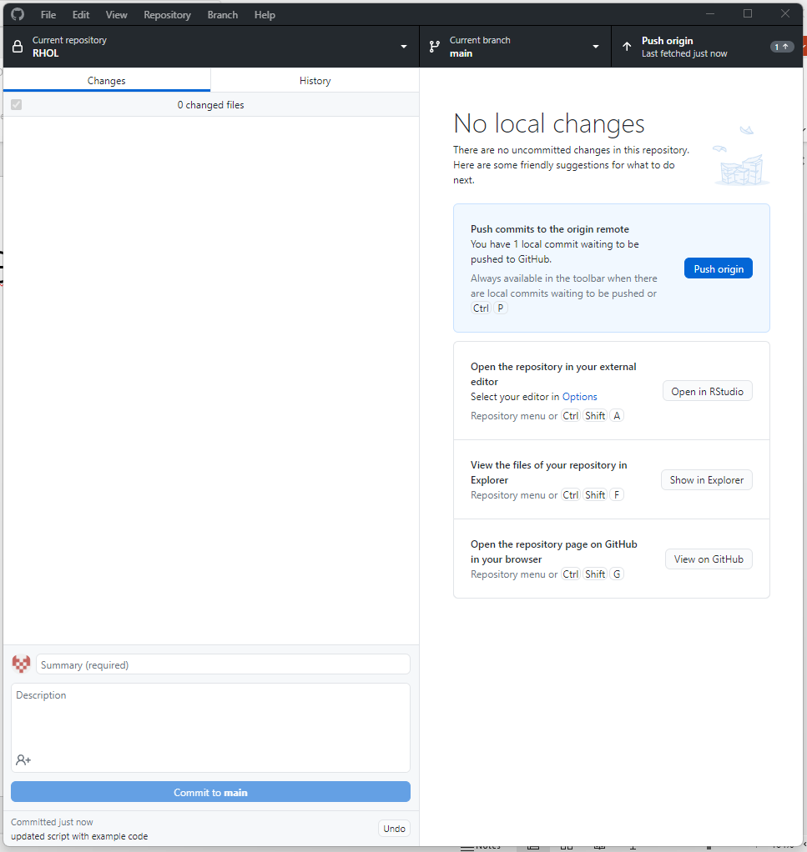
Github Connectivity – Github Desktop

Slide 6
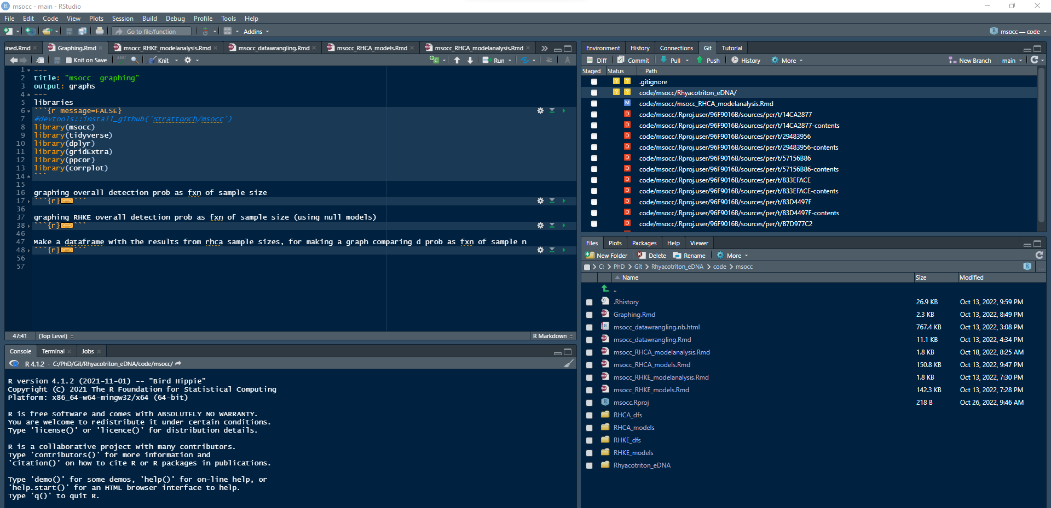
Github Connectivity – R Studio

Slide 7
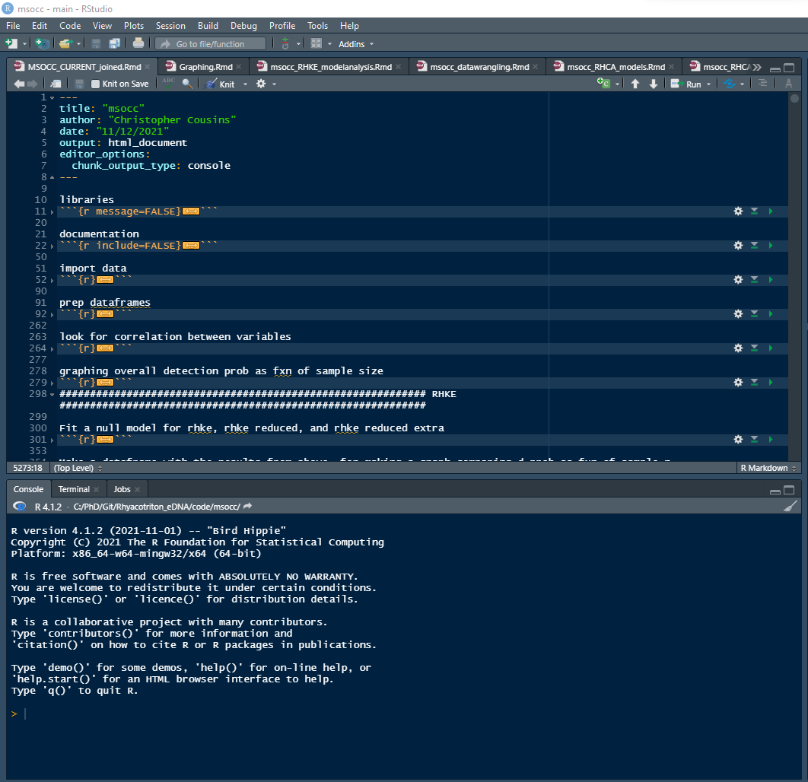
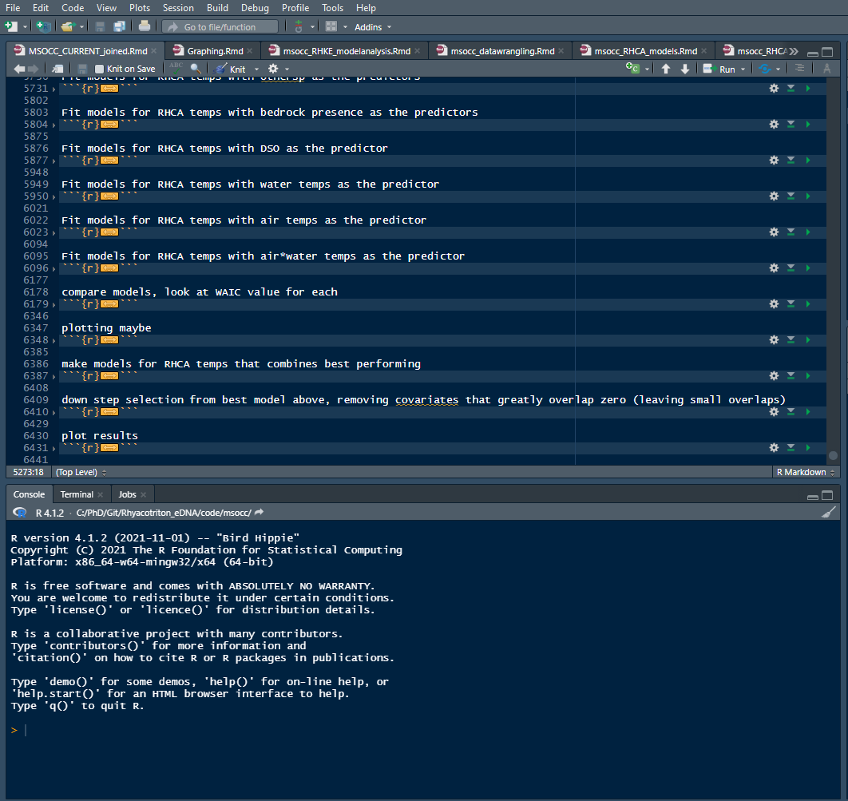
Github and R – Pre-modularization

Slide 8
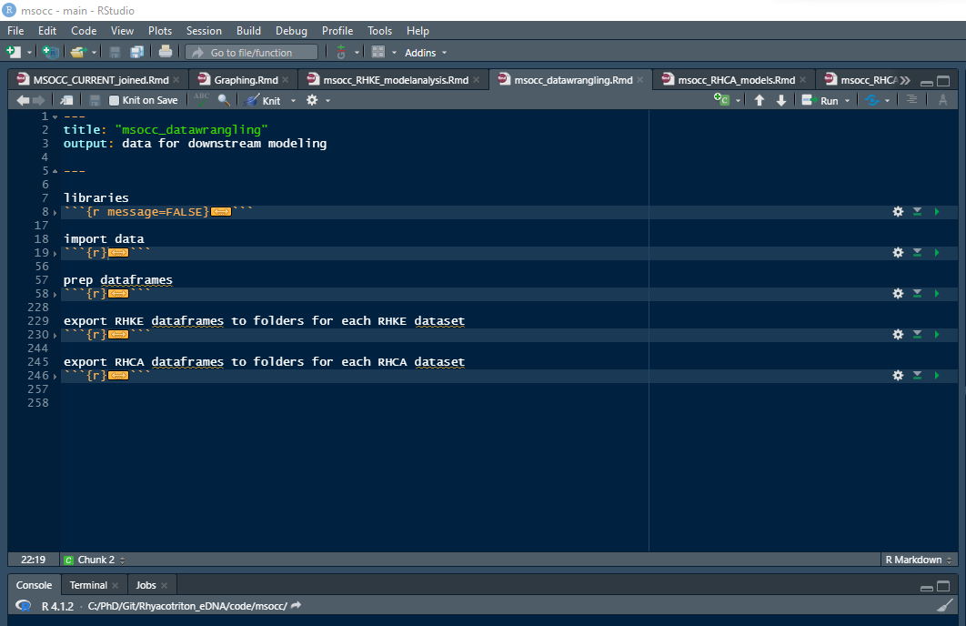
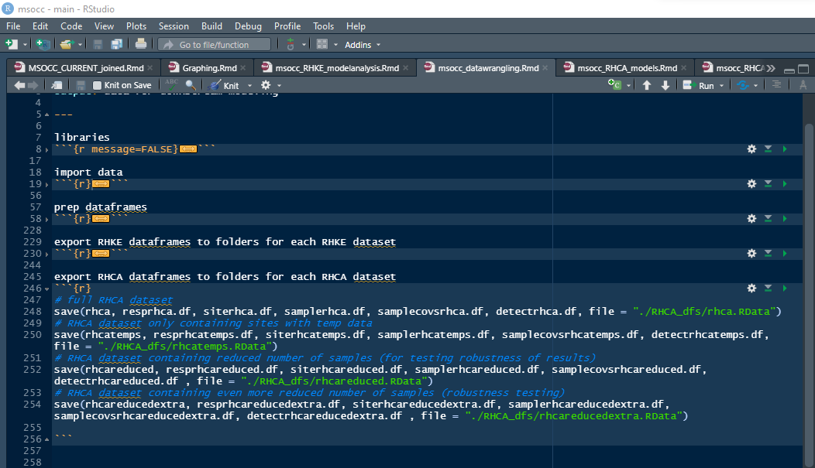
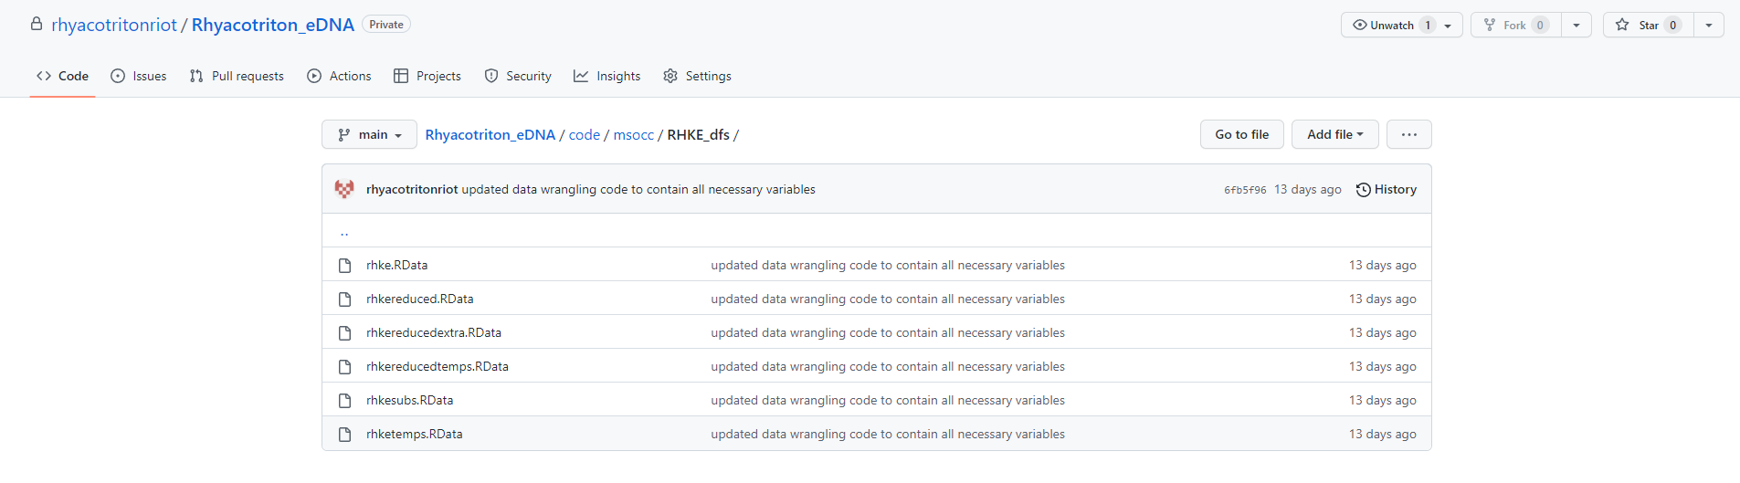
Github and R – Post-modularization

Slide 9
Github and R – Post-modularization

Slide 10
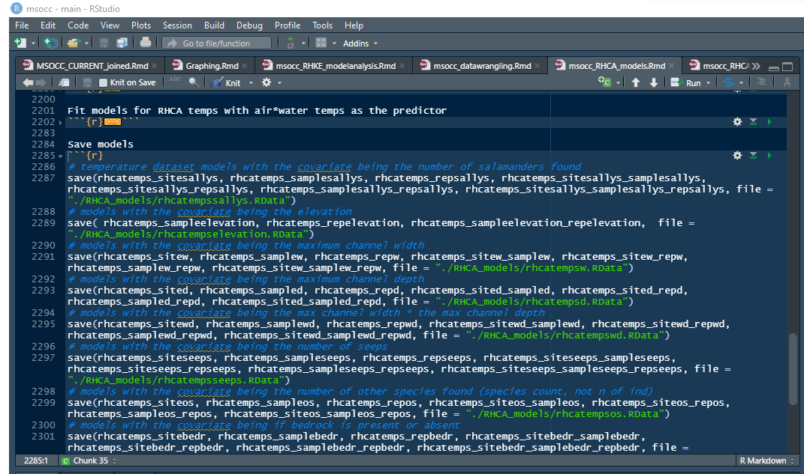
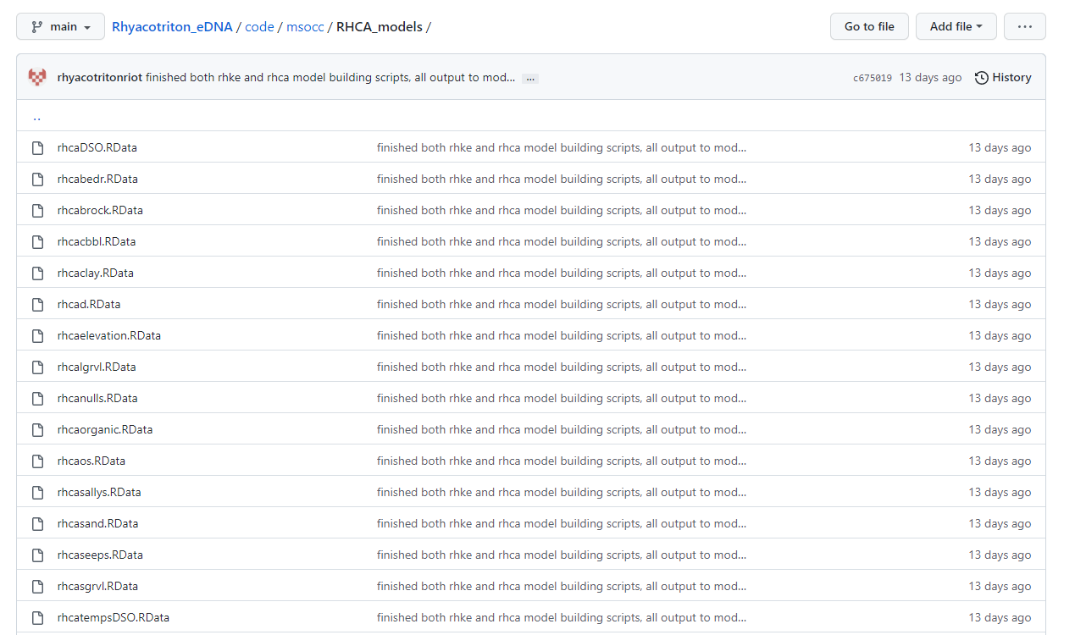
Github and R – Post-modularization

Slide 11
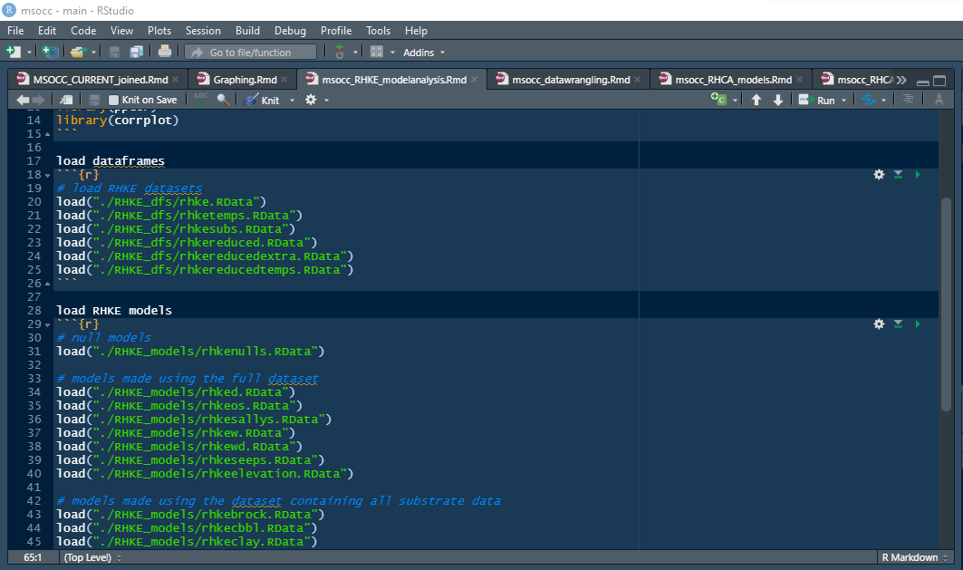
Github and R – Post-modularization

Slide 12
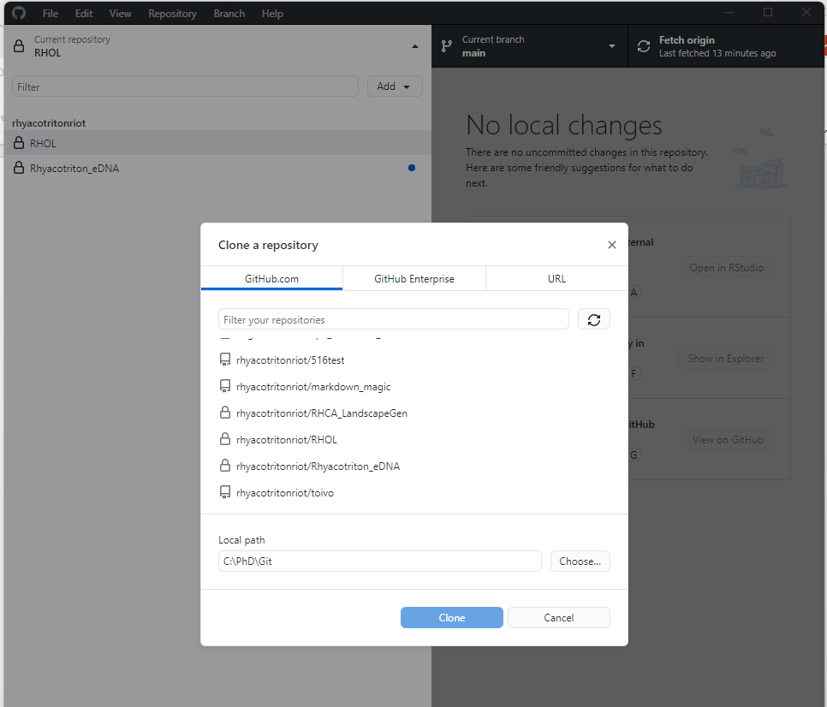
Github – Cloning Repositories

Slide 13
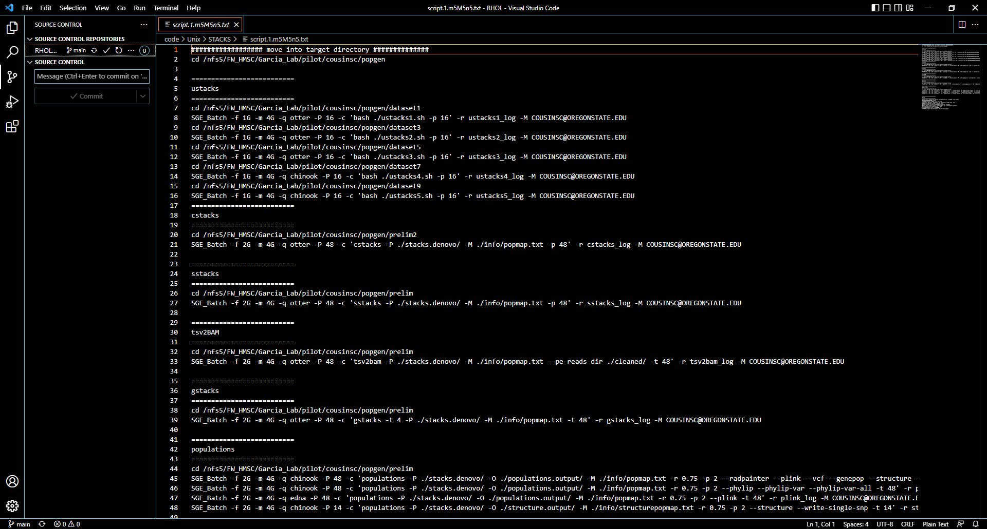
Github Connectivity – Visual Studio Code

Slide 14
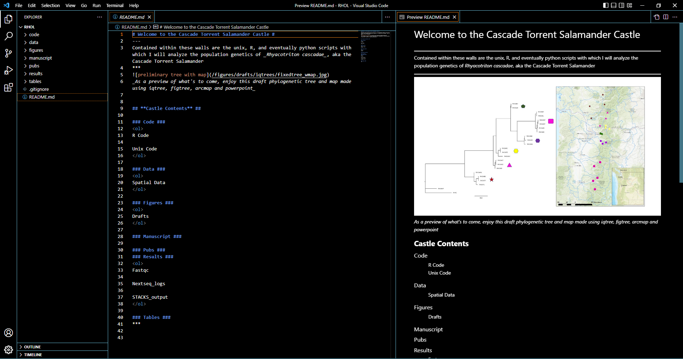
Github Connectivity – Visual Studio Code

